Slide 1
SDH Corporation Members Meeting April 19, 2016 UAW Hall 5:00 p.m.
Welcome
WIFN & Honorary Membership
CKHA Governance
Membership
CKHA Deficit
Imagine Project
Visions of Health Care (Member Recommendation)
Question Period
Adjournment

Slide 2
SDH Board Presentation
Corporate Members Meeting
April 19, 2016

Slide 3
Sydenham District Hospital A small rural hospital
We are a very small rural hospital serving our communities
North Kent County
Wallaceburg
Dresden
Walpole Island First Nations
St. Clair Township
South Lambton County
Sydenham Walpole St. Clair District
Notes:
Small Rural & Northern Hospitals receive special treatment in the grand scheme of funding health care. There are sources of dollars and other considerations that are not available to the rest of hospitals.

Slide 4
CKHA – Sydenham Walpole St. Clair District - BW
ESC LHIN
Bluewater Health
CKHA
Sydenham Walpole St. Clair District
CK FHT
CK CHC
ESC CCAC
CMHA LK
SDH Board
PGH/SHJ Board
Bluewater Health Board
Members of SDH Corporation
Notes:
We are suggesting a new organizational structure for health care in our region. SDH and its partners would be an integrated “one stop shop” for health services and be called the Sydenham Walpole St. Clair District and would be associated with both the CKHA and Bluewater Health. It would form a real “hub” with the ESC LHIN.

Slide 5
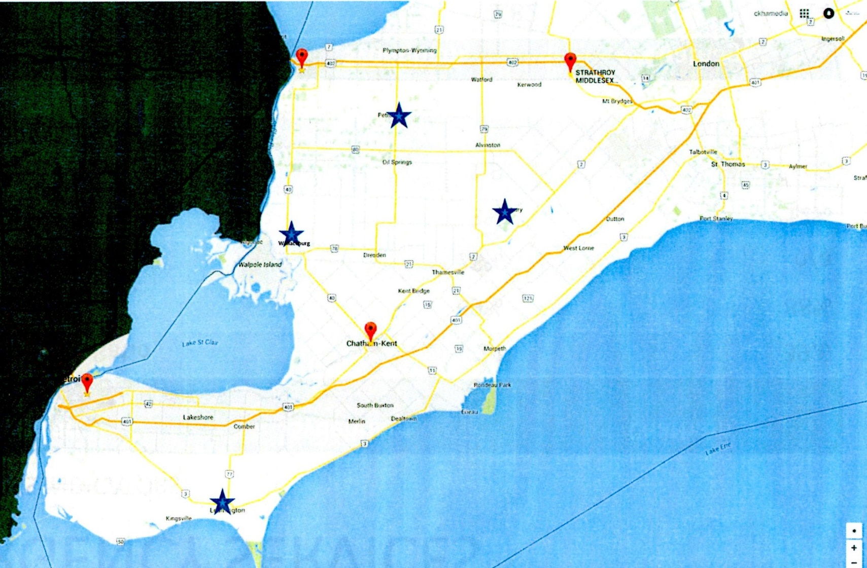
Wallaceburg
Notes:
Wallaceburg is central in the Erie St. Clair LHIN.

Slide 6
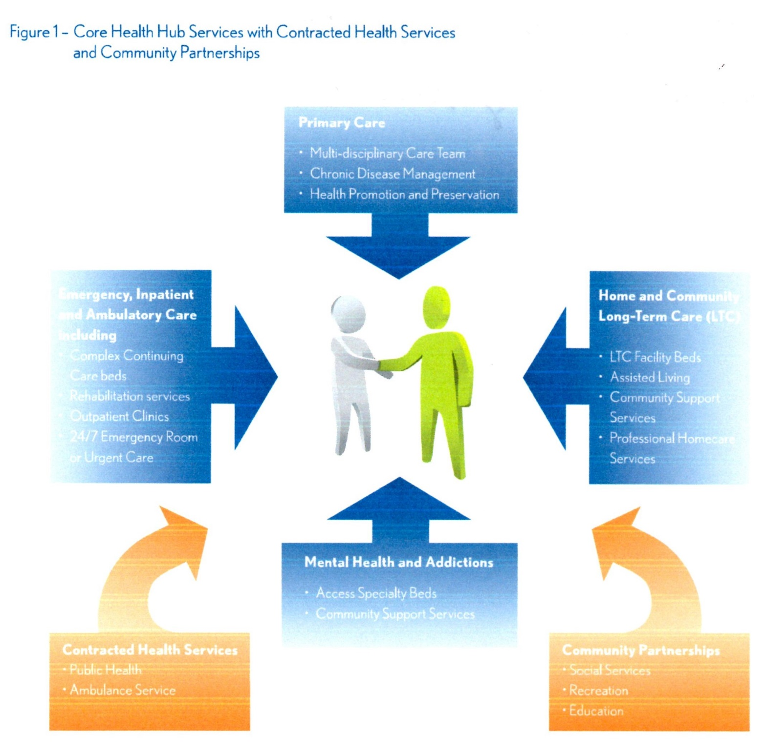
The future of health care for small rural communities
approved by the Ontario Hospital Association
and endorsed by the Ministry of Health.

Slide 7
Other O.H.A. & Ministry Services from Chart (Small Rural Hospitals)
Ability to admit for both acute and complex continuing care in patients’ home communities
Palliative care close to home
Rehabilitation
Obstetrics close to home unless population demographics clearly indicate no need
Dialysis for stable patients
The provision of minor surgeries, and simple geriatrics
Notes:
For interest here are some of the other services shown in the chart that you can’t read

Slide 8
Recommended Core Services Small Rural Hospital
Emergency Services
Medicine Program with in-patient medicine beds
Physician – Specialty of General/Family Practice
In-patient allied health services
Diagnostic & Laboratory Services
Serving the Sydenham Walpole St. Clair District
Notes:
Along with additional funding, Small, Rural and Northern Hospitalsare mandated to provide the following core services.

Slide 9
CKHA Vision of the Future
Notes:
Now, let’s get to the visions of the future for health care in the Sydenham Walpole St. Clair District. What’s this? Technical problems with the slide! Oh no! I forgot that the CKHA has not adopted a vision. That’s right! The CKHA hasn’t approved a vision and have since suspended all CKHA activity.

Slide 10
PGH & SJH Vision of Our Future
Community “Hub” – Integration & Co-Location with service providers
No Emergency Department
16 hours from 7:00 a.m. to 11:00 p.m.
Staffing – no ER Physician(s)
Limited Laboratory Services (“point of care” only)
X-Ray service only
Acute cases taken directly to Chatham
Governance under CKCHC Board (no Corporate Membership)
Notes:
This is the vision that the 2 boards have adopted but have not approved at the Tri-Board. Make no mistake! Their vision/agenda was and still is the elimination of the Emergency Department and any other services presently provided by SDH including Governance by the SDH Board. This proposal eliminates all of you from decision making about health care in the community.

Slide 11
SDH Vision for Our Future
An integrated health care delivery system
Co-location with other health service providers
24/7 Emergency Department
Professional staffing including Physicians, Nurses, Nurse Practitioners
All necessary ancillary services for the ED (eg. Diagnostic & Laboratory)
Helipad
Combination of medicine and observation beds
Maintain ability to accommodate Sarnia/Chatham overflow
Governance under SDH Board (continued Corporate Membership)
A facility that will allow for future expansion in a site to be determined
Notes:
Going forward with a positive outlook the Board has adopted the following points in developing our plan for the hospital. Later in the meeting we hope to put those points in a motion for Corporation Members to approve.

Slide 12
Why cut the SDH Emergency Department?
CKHA reports, data analysis and conclusions are all basically related to
Patient Safety
&
Cost
Notes:
The justification for the CKHA proposal revolves around some facts and some anecdotal evidence and a considerable amount of confidentiality about privacy related to Patient Safety and a few facts, interpretations and confusing conclusions about Cost. We have serious concerns and skepticism about those reports, data and conclusions. For example, one of the issues they never even consider is the requirement for possibly 2 more ambulances and EMS personnel to cover the extra distance transportation. Why aren’t they concerned … because the municipality would have to pay for it with your increased taxes. Sydenham is more efficient in the day shift, Chatham is more efficient in the afternoon shift and then we have the night shift! They treat the health care business like a private company where an uneconomical night shift is simply cancelled. There is definitely a spin being put on this! This kind of cost analysis is appropriate for a for-profit business and it might make sense to cut a less than profitable shift. This is not the type of model we support or believe should be used in the business of health care because the message is if you cost too much you don’t get service. Sydenham is more efficient in the day shift, Chatham is more efficient in the afternoon shift and then we have the night shift! Answers to questions are usually not quite what they should be for accuracy and clarity. For example, we have asked several times why it takes almost 4 hours longer to get from SDH to a Windsor hospital for a necessary cardiac procedure than it takes to get from Chatham to the same hospital Actually the numbers are 370 minutes compared to 162 minutes. For reference, the acceptable time is 90 minutes which only one other hospital achieves and it is in Windsor. Chatham, Leamington and Windsor Regional are all in the 140 to 160 minute range. These are only 2 examples of ER closure justifications which we are taking with a tablespoon not a pinch of salt.

Slide 13
The
Beginning

Slide 14
Be it resolved that the SDH Corporation Members recommend that the SDH Board use the vision (points listed below) presented on April 19, 2016 as the framework for the development of the future of health care in the Sydenham Walpole St. Clair District. Moved by: Kris Lee Seconded by: Conrad Noel
An integrated health care delivery system
Co-location with other health service providers
24/7 Emergency Department
Professional staffing including Physicians, Nurses, Nurse Practitioners
All necessary ancillary services for the ED (eg. Diagnostic & Laboratory)
Helipad
Combination of medicine and observation beds
Maintain ability to accommodate Sarnia/Chatham overflow
Governance under SDH Board (continued Corporate Membership)
A facility that will allow for future expansion in a site to be determined
Carried unanimously

